Slide 1
Announcements
Assignments:
HW7
Due Wed 3/20, 10 pm
P4
Due Thu 3/28, 10 pm
HW8
Plan: Out tonight, due M 3/25

Slide 2

AI: Representation and Problem Solving
Reinforcement Learning
Instructors: Pat Virtue & Stephanie Rosenthal
Slide credits: CMU AI and http://ai.berkeley.edu

Slide 3
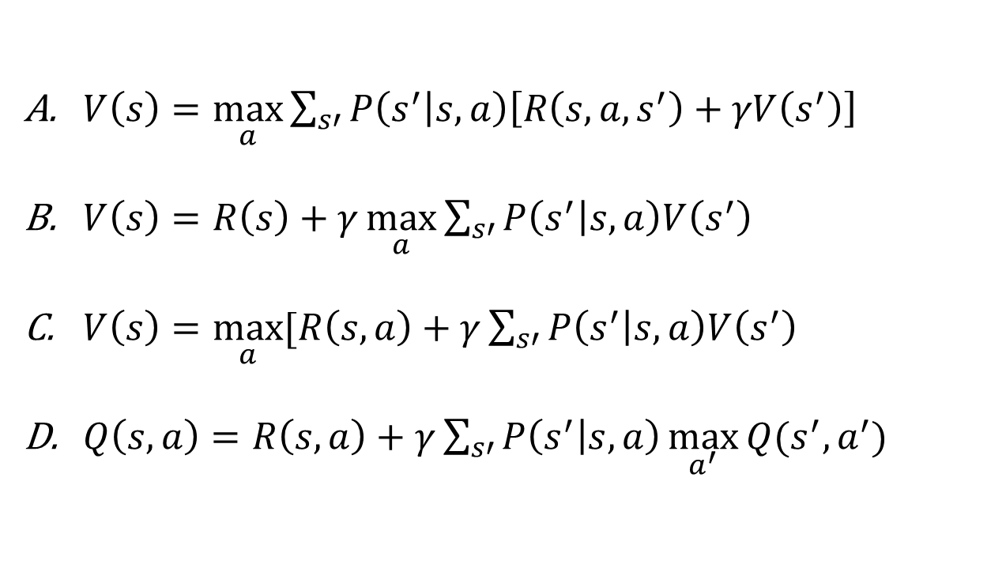
Piazza Poll 1
Rewards may depend on any combination of state, action, next state.
Which of the following are valid formulations of the Bellman equations?
$V\left(s\right)=\max_{a}{\sum_{s′}{P\left(s^{′} | s,a\right)\left[R\left(s,a,s^{′}\right)+γV\left(s^{′}\right)\right]}}$
$V\left(s\right)=R\left(s\right)+γ\max_{a}{\sum_{s′}{P\left(s^{′} | s,a\right)V\left(s^{′}\right)}}$
$V\left(s\right)=\max_{a}{[R\left(s, a\right)+γ\sum_{s′}{P\left(s^{′} | s,a\right)V\left(s^{′}\right)}}$
$Q\left(s,a\right)=R\left(s, a\right)+γ\sum_{s′}{P\left(s^{′} | s,a\right)\max_{a^{′}}{Q(s^{′},a^{′})} }$

Slide 4

Piazza Poll 1
Rewards may depend on any combination of state, action, next state.
Which of the following are valid formulations of the Bellman equations?
$V\left(s\right)=\max_{a}{\sum_{s′}{P\left(s^{′} | s,a\right)\left[R\left(s,a,s^{′}\right)+γV\left(s^{′}\right)\right]}}$
$V\left(s\right)=R\left(s\right)+γ\max_{a}{\sum_{s′}{P\left(s^{′} | s,a\right)V\left(s^{′}\right)}}$
$V\left(s\right)=\max_{a}{[R\left(s, a\right)+γ\sum_{s′}{P\left(s^{′} | s,a\right)V\left(s^{′}\right)}}$
$Q\left(s,a\right)=R\left(s, a\right)+γ\sum_{s′}{P\left(s^{′} | s,a\right)\max_{a^{′}}{Q(s^{′},a^{′})} }$

Slide 5

Piazza Poll 2
Which of the following are used in policy iteration?
$$V_{k+1}\left(s\right)=\max_{a}{\sum_{s′}{P\left(s^{′} | s,a\right)\left[R\left(s,a,s^{′}\right)+γV_{k}\left(s^{′}\right)\right]}}, ∀ s$$
$$Q_{k+1}\left(s,a\right)=\sum_{s′}{P\left(s^{′} | s,a\right)[R\left(s,a,s^{′}\right)+γ\max_{a^{′}}{Q_{k}(s^{′},a^{′})]}, } ∀ s,a$$
$$π_{V}\left(s\right)=\underset{a}{argmax}{\sum_{s′}{P\left(s^{′} | s,a\right)[R\left(s,a,s^{′}\right)+γV\left(s^{′}\right)]}}, ∀ s$$
$$V_{k+1}^{π}\left(s\right)=\sum_{s′}{P\left(s^{′} | s,π\left(s\right)\right)[R\left(s,π\left(s\right),s^{′}\right)+γV_{k}^{π}\left(s^{′}\right)]}, ∀ s$$
$$π_{new}\left(s\right)=\underset{a}{argmax}{\sum_{s′}{P\left(s^{′} | s,a\right)\left[R\left(s,a,s^{′}\right)+γV^{π_{old}}\left(s^{′}\right)\right]}}, ∀ s$$
Value iteration:
Q-iteration:
Policy extraction:
Policy evaluation:
Policy improvement:

Slide 6
Piazza Poll 2
Which of the following are used in policy iteration?
$$V_{k+1}\left(s\right)=\max_{a}{\sum_{s′}{P\left(s^{′} | s,a\right)\left[R\left(s,a,s^{′}\right)+γV_{k}\left(s^{′}\right)\right]}}, ∀ s$$
$$Q_{k+1}\left(s,a\right)=\sum_{s′}{P\left(s^{′} | s,a\right)[R\left(s,a,s^{′}\right)+γ\max_{a^{′}}{Q_{k}(s^{′},a^{′})]}, } ∀ s,a$$
$$π_{V}\left(s\right)=\underset{a}{argmax}{\sum_{s′}{P\left(s^{′} | s,a\right)[R\left(s,a,s^{′}\right)+γV\left(s^{′}\right)]}}, ∀ s$$
$$V_{k+1}^{π}\left(s\right)=\sum_{s′}{P\left(s^{′} | s,π\left(s\right)\right)[R\left(s,π\left(s\right),s^{′}\right)+γV_{k}^{π}\left(s^{′}\right)]}, ∀ s$$
$$π_{new}\left(s\right)=\underset{a}{argmax}{\sum_{s′}{P\left(s^{′} | s,a\right)\left[R\left(s,a,s^{′}\right)+γV^{π_{old}}\left(s^{′}\right)\right]}}, ∀ s$$
Value iteration:
Q-iteration:
Policy extraction:
Policy evaluation:
Policy improvement:

Slide 7
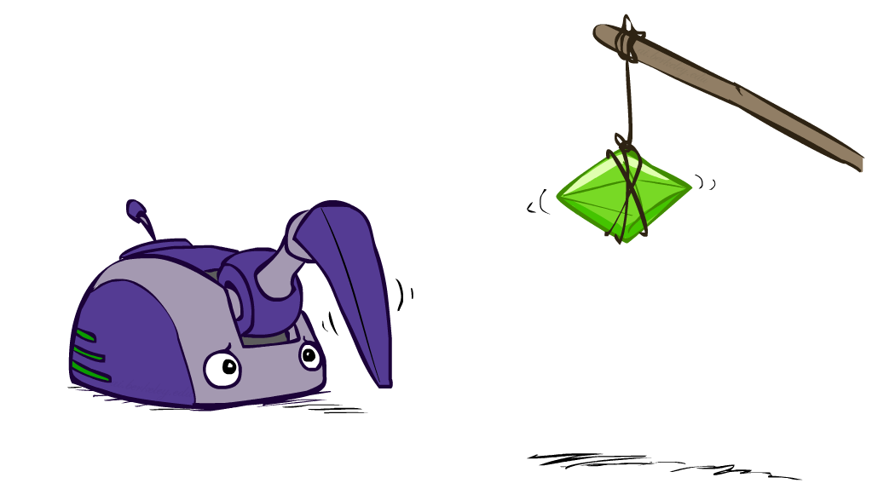
Reinforcement Learning

Slide 8
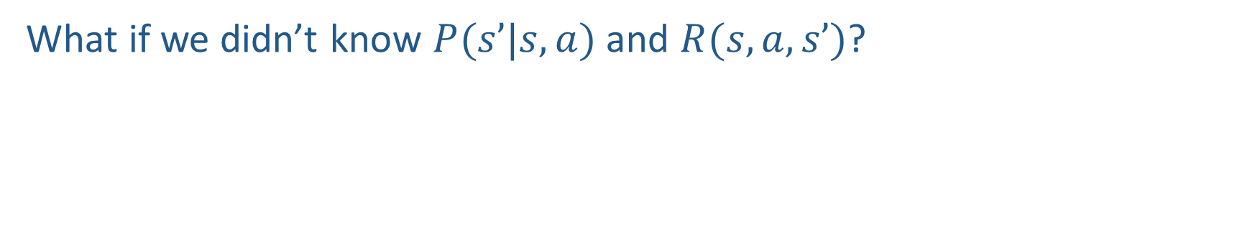
Reinforcement learning
What if we didn’t know $P(s’|s,a)$and $R(s,a,s’)$?
$$V_{k+1}\left(s\right)=\max_{a}{\sum_{s′}{P\left(s^{′} | s,a\right)\left[R\left(s,a,s^{′}\right)+γV_{k}\left(s^{′}\right)\right]}}, ∀ s$$
$$Q_{k+1}\left(s,a\right)=\sum_{s′}{P\left(s^{′} | s,a\right)[R\left(s,a,s^{′}\right)+γ\max_{a^{′}}{Q_{k}(s^{′},a^{′})]}, } ∀ s,a$$
$$π_{V}\left(s\right)=\underset{a}{argmax}{\sum_{s′}{P\left(s^{′} | s,a\right)[R\left(s,a,s^{′}\right)+γV\left(s^{′}\right)]}}, ∀ s$$
$$V_{k+1}^{π}\left(s\right)=\sum_{s′}{P\left(s^{′} | s,π\left(s\right)\right)[R\left(s,π\left(s\right),s^{′}\right)+γV_{k}^{π}\left(s^{′}\right)]}, ∀ s$$
$$π_{new}\left(s\right)=\underset{a}{argmax}{\sum_{s′}{P\left(s^{′} | s,a\right)\left[R\left(s,a,s^{′}\right)+γV^{π_{old}}\left(s^{′}\right)\right]}}, ∀ s$$
Value iteration:
Q-iteration:
Policy extraction:
Policy evaluation:
Policy improvement:

Slide 9
Reinforcement Learning
Agent
State: s
Reward: r
Actions: a
Environment
Basic idea:
Receive feedback in the form of rewards
Agent’s utility is defined by the reward function
Must (learn to) act so as to maximize expected rewards
All learning is based on observed samples of outcomes!
Notes:
Show robot-soccer learning to walk videos (UT Austin):
? Show snake robot:

Slide 10
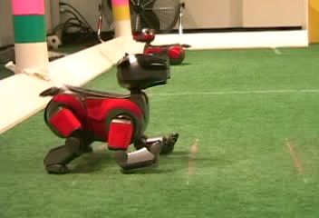
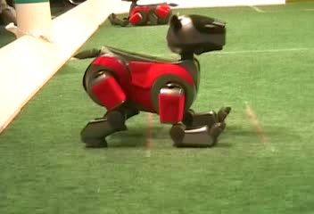
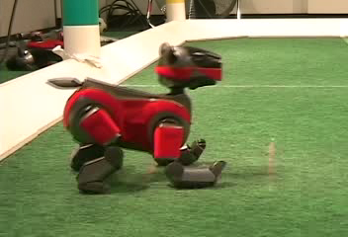
Example: Learning to Walk
Initial
A Learning Trial
After Learning [1K Trials]
[Kohl and Stone, ICRA 2004]
Notes:
Peter Stone, Austin

Slide 11

Example: Learning to Walk
Initial
[Kohl and Stone, ICRA 2004]
[Video: AIBO WALK – initial]

Slide 12

Example: Learning to Walk
Training
[Kohl and Stone, ICRA 2004]
[Video: AIBO WALK – training]

Slide 13

Example: Learning to Walk
Finished
[Kohl and Stone, ICRA 2004]
[Video: AIBO WALK – finished]

Slide 14
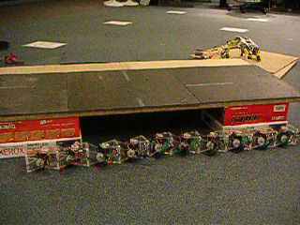
Example: Sidewinding
[Andrew Ng]
[Video: SNAKE – climbStep+sidewinding]

Slide 15

Example: Toddler Robot
[Tedrake, Zhang and Seung, 2005]
[Video: TODDLER – 40s]
Notes:
MIT

Slide 16
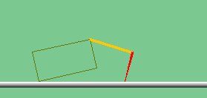
The Crawler!
[Demo: Crawler Bot (L10D1)] [You, in Project 3]
Notes:
At times no reward accumulated at all, just sitting still

Slide 17
Demo Crawler Bot

Slide 18
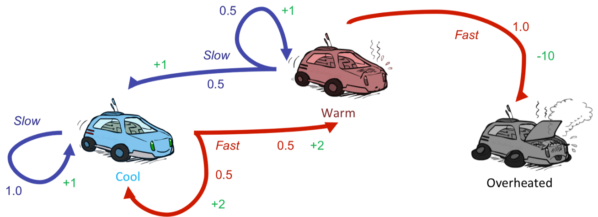
Reinforcement Learning
Still assume a Markov decision process (MDP):
A set of states s ∈ S
A set of actions (per state) A
A model T(s,a,s’)
A reward function R(s,a,s’)
Still looking for a policy π(s)
New twist: don’t know T or R
I.e. we don’t know which states are good or what the actions do
Must actually try actions and states out to learn

Slide 19
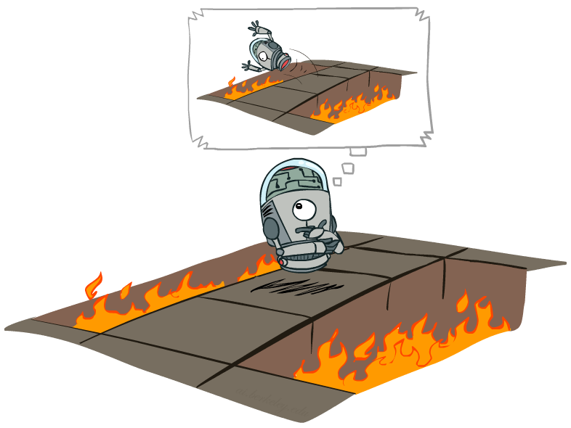
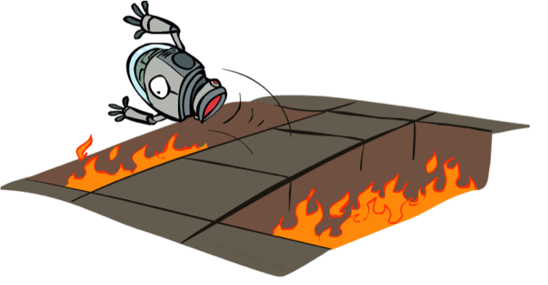
Offline (MDPs) vs. Online (RL)
Offline Solution
Online Learning

Slide 20

Model-Based Learning

Slide 21

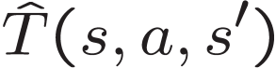

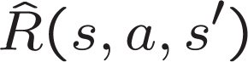
Model-Based Learning
Model-Based Idea:
Learn an approximate model based on experiences
Solve for values as if the learned model were correct
Step 1: Learn empirical MDP model
Count outcomes s’ for each s, a
Normalize to give an estimate of
Discover each when we experience (s, a, s’)
Step 2: Solve the learned MDP
For example, use value iteration, as before

Slide 22
Example: Model-Based Learning
Input Policy π
Observed Episodes (Training)
Learned Model
Episode 1
Episode 2
T(s,a,s’).
T(B, east, C) =
T(C, east, D) =
T(C, east, A) =
…
R(s,a,s’).
R(B, east, C) =
R(C, east, D) =
R(D, exit, x) =
…
 | A
B | C | D
 | E
B, east, C, -1
C, east, D, -1
D, exit, x, +10
B, east, C, -1
C, east, D, -1
D, exit, x, +10
Episode 3
Episode 4
E, north, C, -1
C, east, D, -1
D, exit, x, +10
E, north, C, -1
C, east, A, -1
A, exit, x, -10
Assume: γ = 1

Slide 23
Example: Model-Based Learning
Input Policy π
Observed Episodes (Training)
Learned Model
Episode 1
Episode 2
T(s,a,s’).
T(B, east, C) = 1.00
T(C, east, D) = 0.75
T(C, east, A) = 0.25
…
R(s,a,s’).
R(B, east, C) = -1
R(C, east, D) = -1
R(D, exit, x) = +10
…
 | A
B | C | D
 | E
B, east, C, -1
C, east, D, -1
D, exit, x, +10
B, east, C, -1
C, east, D, -1
D, exit, x, +10
Episode 3
Episode 4
E, north, C, -1
C, east, D, -1
D, exit, x, +10
E, north, C, -1
C, east, A, -1
A, exit, x, -10
Assume: γ = 1

Slide 24
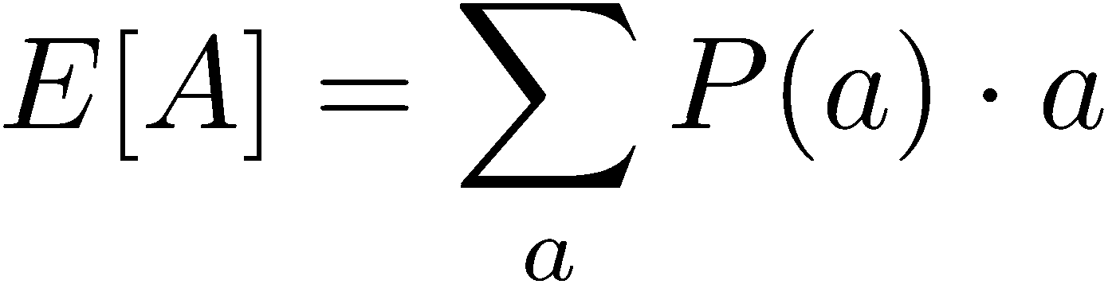
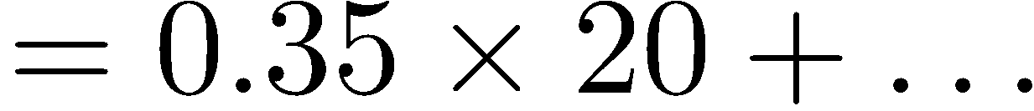
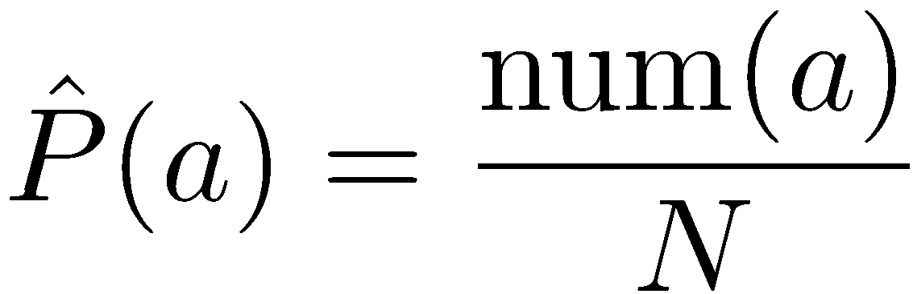
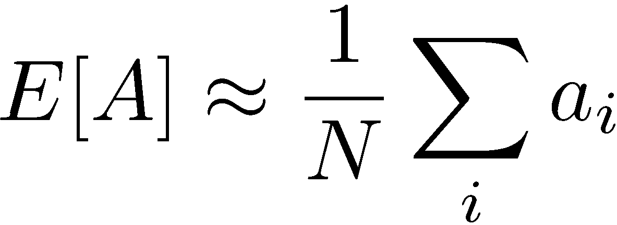
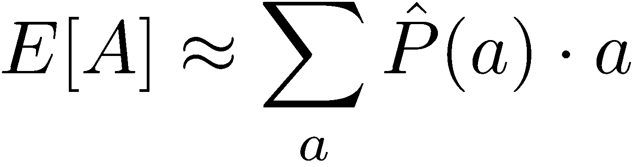
Example: Expected Age
Goal: Compute expected age of 15-381 students
Known P(A)
Without P(A), instead collect samples [a₁, a₂, … a_{N}]
Unknown P(A): “Model Based”
Unknown P(A): “Model Free”
Why does this work? Because eventually you learn the right model.
Why does this work? Because samples appear with the right frequencies.

Slide 25
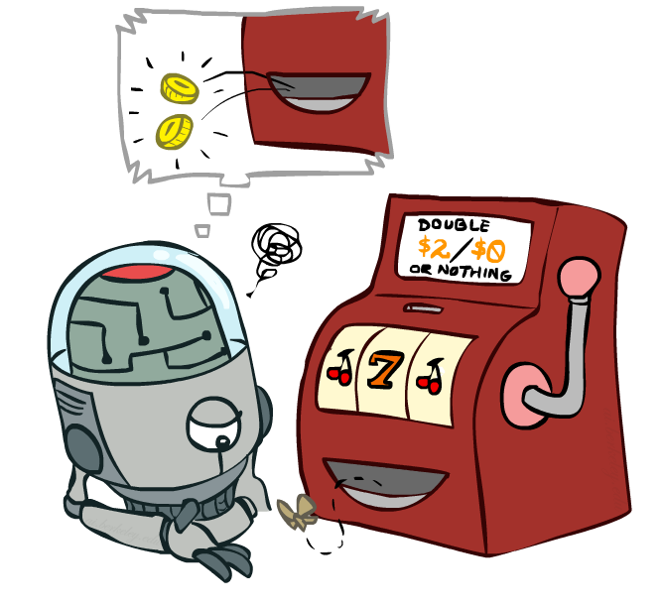
Model-Free Learning

Slide 26
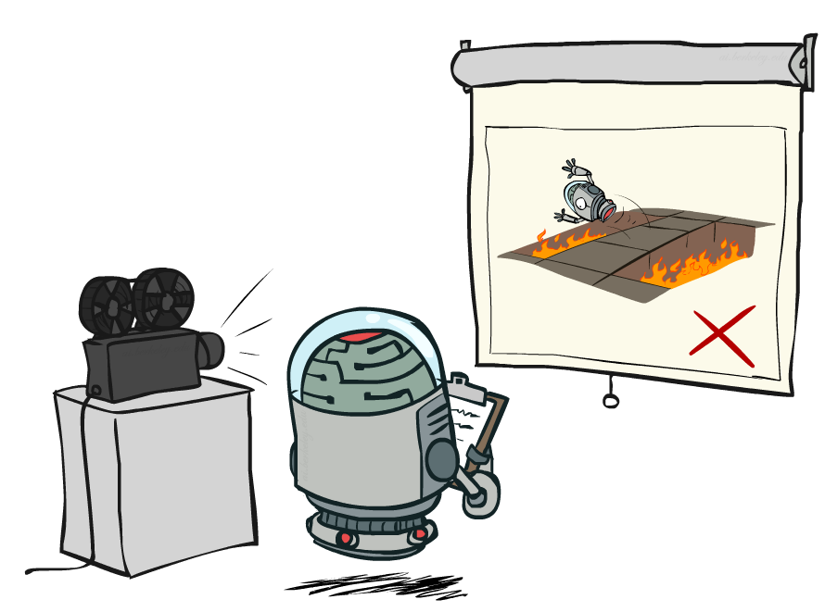
Passive Reinforcement Learning

Slide 27
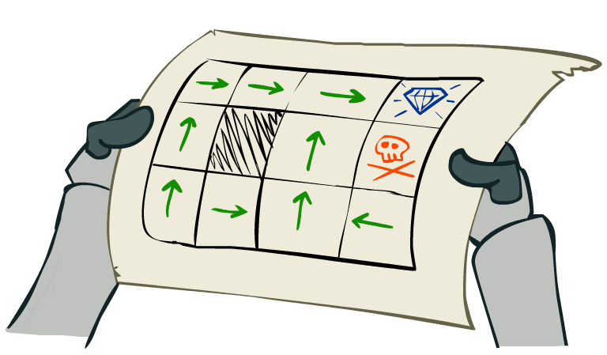
Passive Reinforcement Learning
Simplified task: policy evaluation
Input: a fixed policy π(s)
You don’t know the transitions T(s,a,s’)
You don’t know the rewards R(s,a,s’)
Goal: learn the state values
In this case:
Learner is “along for the ride”
No choice about what actions to take
Just execute the policy and learn from experience
This is NOT offline planning! You actually take actions in the world.

Slide 28
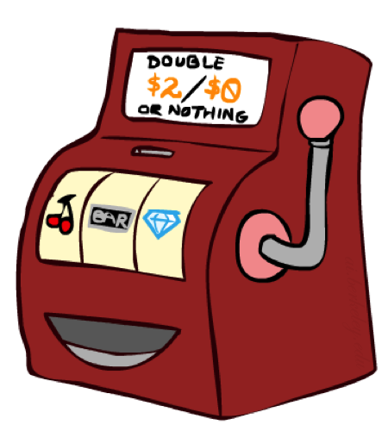
Direct Evaluation
Goal: Compute values for each state under π
Idea: Average together observed sample values
Act according to π
Every time you visit a state, write down what the sum of discounted rewards turned out to be
Average those samples
This is called direct evaluation

Slide 29
Example: Direct Evaluation
Input Policy π
Observed Episodes (Training)
Output Values
Episode 1
Episode 2
 | A
B | C | D
 | E
 | A
B | C | D
 | E
B, east, C, -1
C, east, D, -1
D, exit, x, +10
B, east, C, -1
C, east, D, -1
D, exit, x, +10
-10
+8
+4
+10
Episode 3
Episode 4
-2
E, north, C, -1
C, east, D, -1
D, exit, x, +10
E, north, C, -1
C, east, A, -1
A, exit, x, -10
Assume: γ = 1

Slide 30
Problems with Direct Evaluation
What’s good about direct evaluation?
It’s easy to understand
It doesn’t require any knowledge of T, R
It eventually computes the correct average values, using just sample transitions
What bad about it?
It wastes information about state connections
Each state must be learned separately
So, it takes a long time to learn
Output Values
 | A
B | C | D
 | E
-10
+8
+4
+10
-2
If B and E both go to C under this policy, how can their values be different?

Slide 31
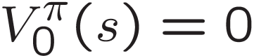

Why Not Use Policy Evaluation?
s
Simplified Bellman updates calculate V for a fixed policy:
Each round, replace V with a one-step-look-ahead layer over V
This approach fully exploited the connections between the states
Unfortunately, we need T and R to do it!
Key question: how can we do this update to V without knowing T and R?
In other words, how to we take a weighted average without knowing the weights?
π(s)
s, π(s)
s, π(s),s’
s’

Slide 32
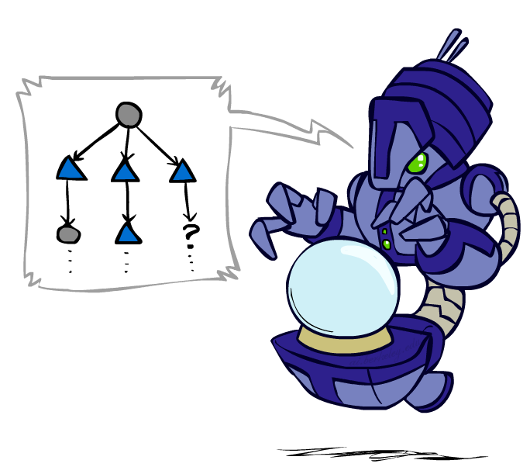




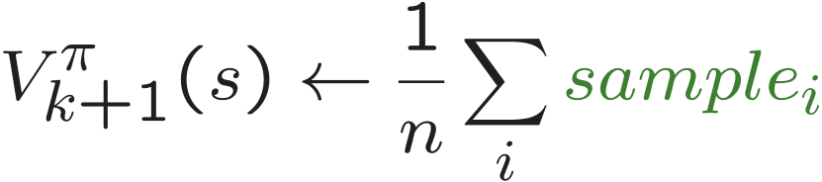
Sample-Based Policy Evaluation?
We want to improve our estimate of V by computing these averages:
Idea: Take samples of outcomes s’ (by doing the action!) and average
s
π(s)
s, π(s)
s, π(s),s’
s₁'
s₂'
s'
s₃'
Almost! But we can’t rewind time to get sample after sample from state s.

Slide 33
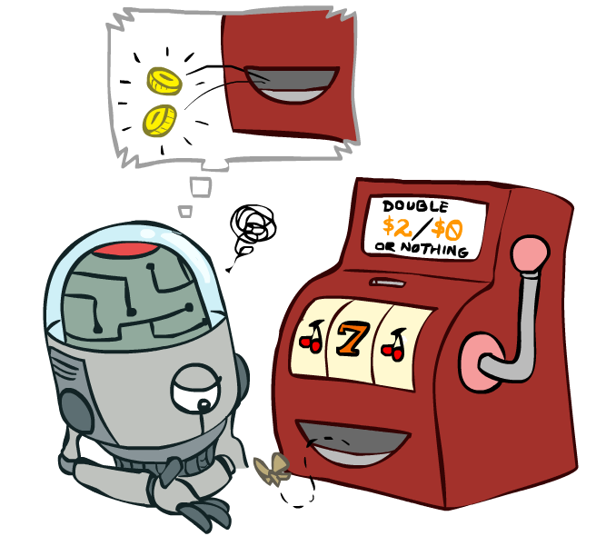
Temporal Difference Learning

Slide 34



Temporal Difference Learning
Big idea: learn from every experience!
Update V(s) each time we experience a transition (s, a, s’, r)
Likely outcomes s’ will contribute updates more often
Temporal difference learning of values
Policy still fixed, still doing evaluation!
Move values toward value of whatever successor occurs: running average
s
π(s)
s, π(s)
s’
Sample of V(s):
Update to V(s):
Same update:

Slide 35

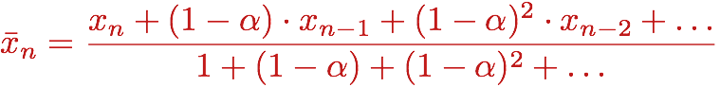
Exponential Moving Average
Exponential moving average
The running interpolation update:
Makes recent samples more important:
Forgets about the past (distant past values were wrong anyway)
Decreasing learning rate (alpha) can give converging averages

Slide 36

Example: Temporal Difference Learning
States
Observed Transitions
B, east, C, -2
C, east, D, -2
 | A
B | C | D
 | E
 | 0
0 | 0 | 8
 | 0
 | 0
-1 | 0 | 8
 | 0
 | 0
-1 | 3 | 8
 | 0
Assume: γ = 1, α = 1/2

Slide 37
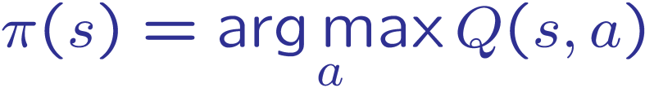
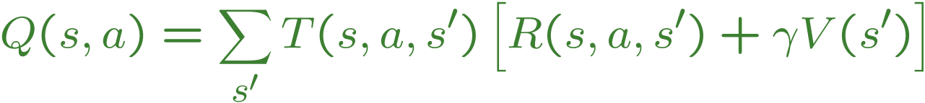
Problems with TD Value Learning
TD value leaning is a model-free way to do policy evaluation, mimicking Bellman updates with running sample averages
However, if we want to turn values into a (new) policy, we’re sunk:
Idea: learn Q-values, not values
Makes action selection model-free too!
s
a
s, a
s,a,s’
s’

Slide 38
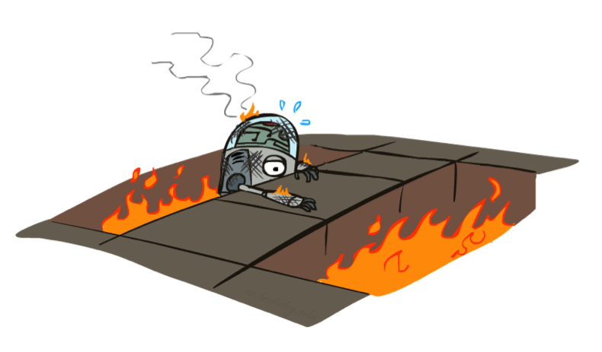
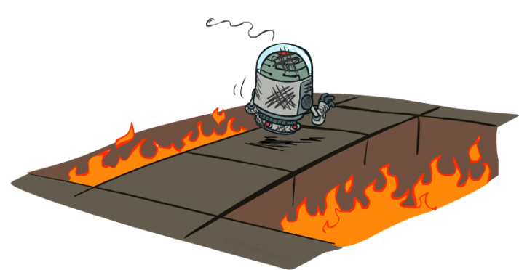
Active Reinforcement Learning

Slide 39
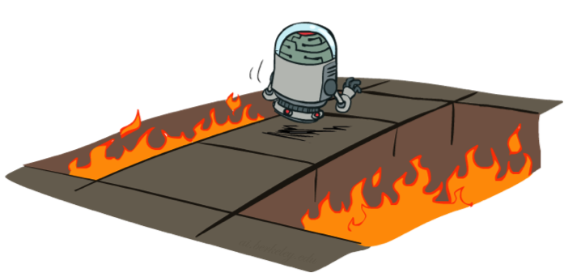
Active Reinforcement Learning
Full reinforcement learning: optimal policies (like value iteration)
You don’t know the transitions T(s,a,s’)
You don’t know the rewards R(s,a,s’)
You choose the actions now
Goal: learn the optimal policy / values
In this case:
Learner makes choices!
Fundamental tradeoff: exploration vs. exploitation
This is NOT offline planning! You actually take actions in the world and find out what happens…

Slide 40


Detour: Q-Value Iteration
Value iteration: find successive (depth-limited) values
Start with V₀(s) = 0, which we know is right
Given V_{k}, calculate the depth k+1 values for all states:
But Q-values are more useful, so compute them instead
Start with Q₀(s,a) = 0, which we know is right
Given Q_{k}, calculate the depth k+1 q-values for all q-states:

Slide 41
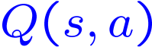


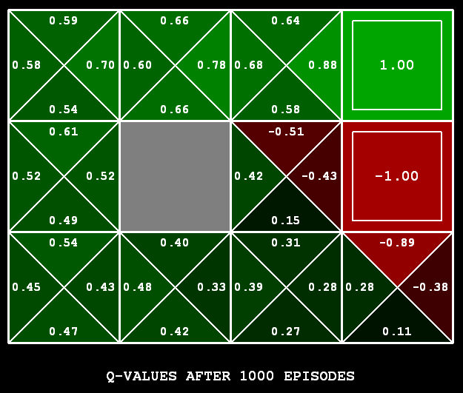
Q-Learning
Q-Learning: sample-based Q-value iteration
Learn Q(s,a) values as you go
Receive a sample (s,a,s’,r)
Consider your old estimate:
Consider your new sample estimate:
Incorporate the new estimate into a running average:
[Demo: Q-learning – gridworld (L10D2)]
[Demo: Q-learning – crawler (L10D3)]

Slide 42
Demo Q-Learning -- Gridworld

Slide 43
Demo Q-Learning -- Crawler

Slide 44

Q-Learning Properties
Amazing result: Q-learning converges to optimal policy -- even if you’re acting suboptimally!
This is called off-policy learning
Caveats:
You have to explore enough
You have to eventually make the learning rate
small enough
… but not decrease it too quickly
Basically, in the limit, it doesn’t matter how you select actions (!)

